Slide 1
Locality-Sensitive Hashing
Bendegúz Timár

Slide 2
Shingling
Shingle: a short string that appear in the document
k-shingling: produce all the k-long shingles of the document
What to do with white spaces?
Document: „Learning Data Science is a lifestyle”
Use 4-shingling
= {Lear, earn, arni, rnin, ning, ing_, ng_D, g_Da, _Dat, Data,…}
Word-level shingling: produce all the shingles that contain a number of consecutive words of the document
Document: „Learning Data Science is a lifestyle”
Use word-level shingling, shingle-size 2
= {Learning Data, Data Science, Science is, is a, a lifestyle}

Slide 3
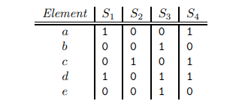
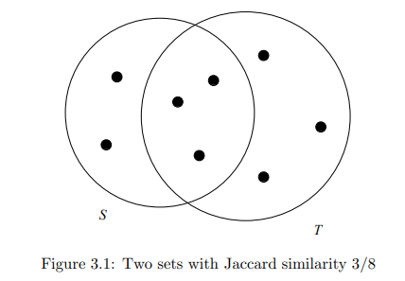
Locality-sensitive hashing for the Jaccard similarty
Algorithm
Shingle the document => get set-representation
The Jaccard similarity between two sets is the relative number of elements these sets have in common: J(A, B) = |A ∩ B| / |A ∪ B|
Generate Characteristic Matrix
Sets: {a, d}; {c}; {b, d, e}; {a, c, d}
Generate the signature using MinHash
MinHash value: the index of the first row with the value of 1
Signature: a vector of MinHash values using different permutations of the universal set
-- here starts LSH --
Group the signature into bands
Hash each band to a bucket
Similar bands hash to the same bucket
Compare each pair of sets for exact Jaccard-similarity
Takes a lot of time and memory
Usually an estimate is good enough

Slide 4
The dataset
medical-nlp dataset
Corpus of medical transcriptions
Has almost 5000 entries (documents), the app only uses 400
https://github.com/socd06/medical-nlp

Slide 5
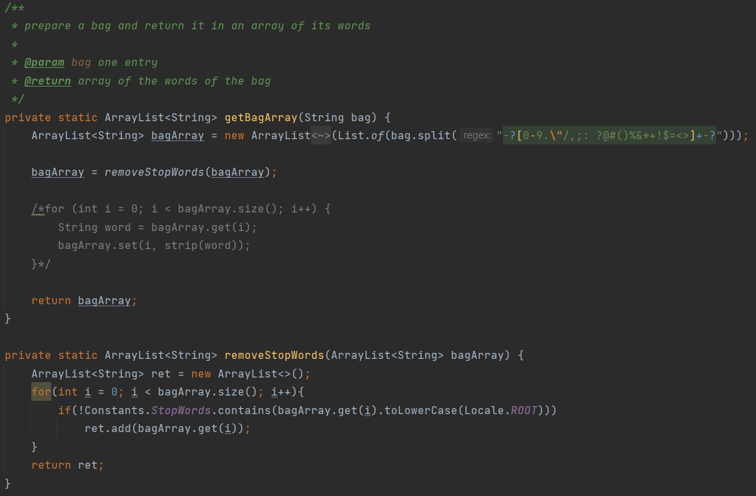
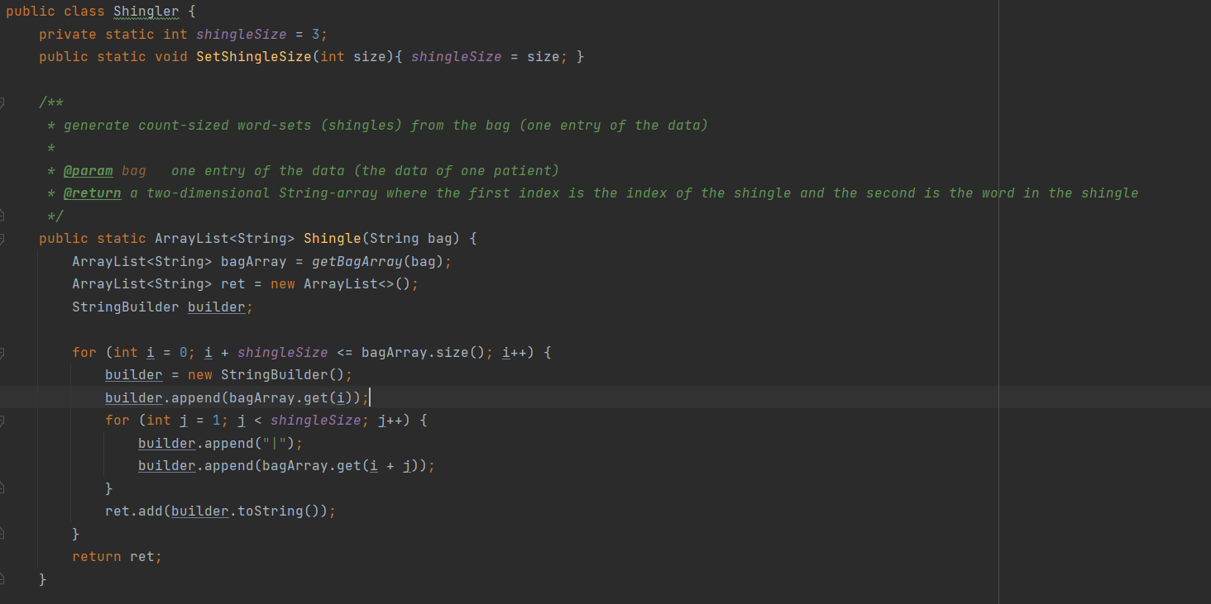

Slide 6
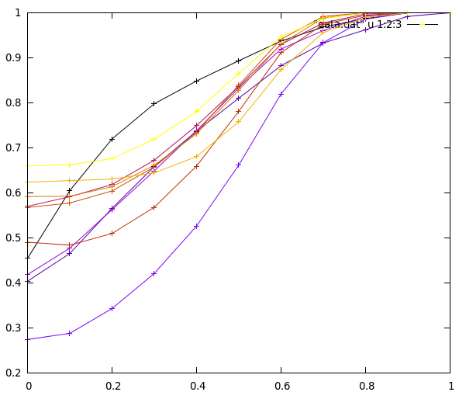
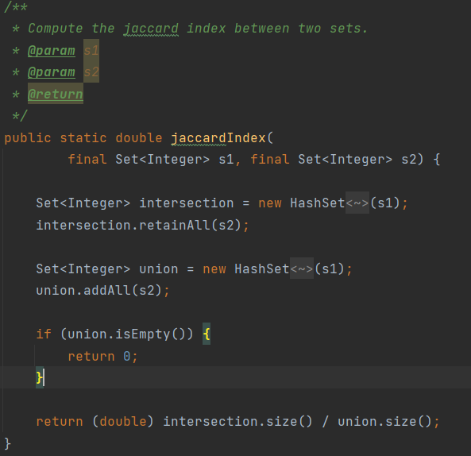
Public implementation of LSH
https://github.com/tdebatty/java-LSH
Uses standard logic for Jaccard similarities
Parameters of the hashing function initialized
two LSH objects => different hashes and signatures for the same input vector
two executions of your program => different hashes and signatures for the same input vector
the signatures produced by two different LSH objects can’t be used to estimate similarity between vectors

Slide 7
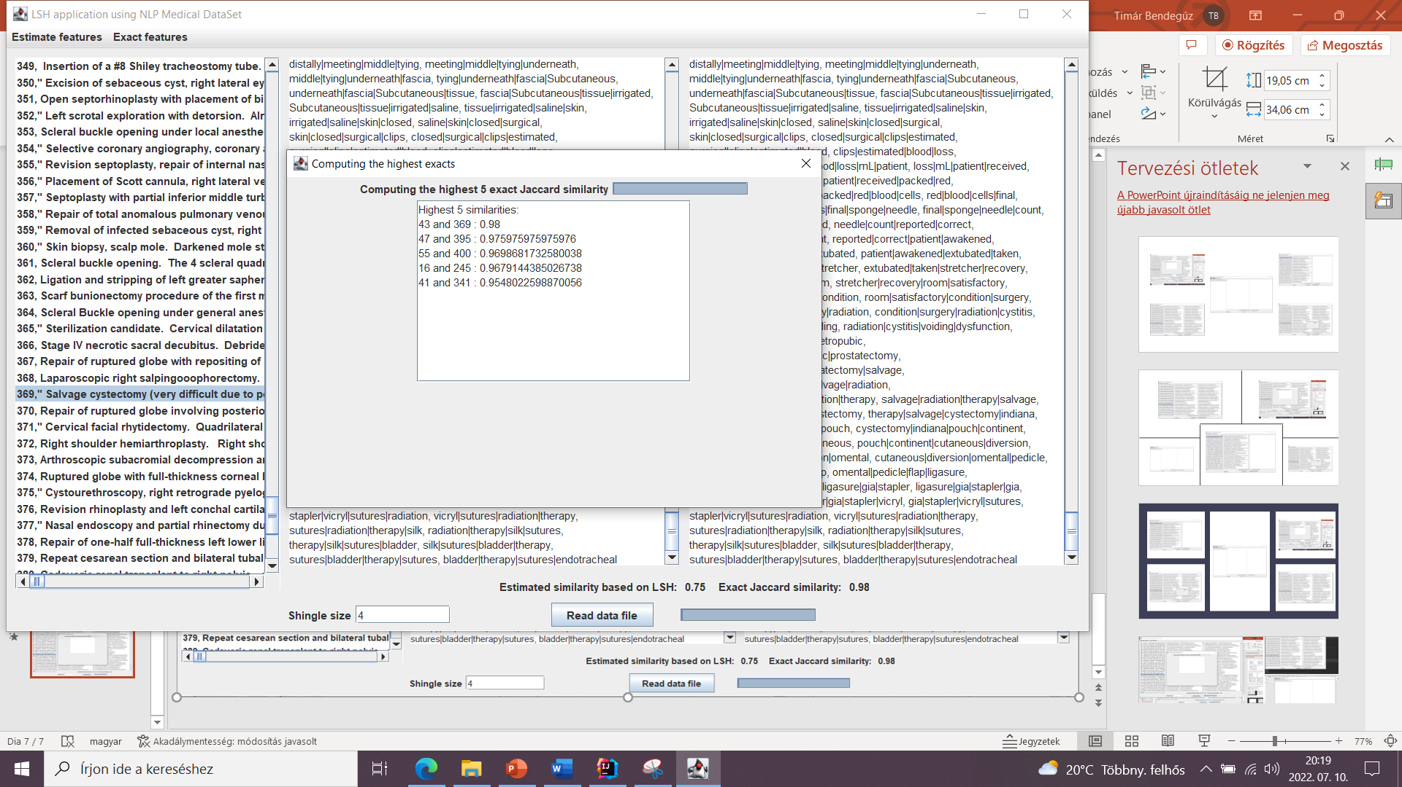
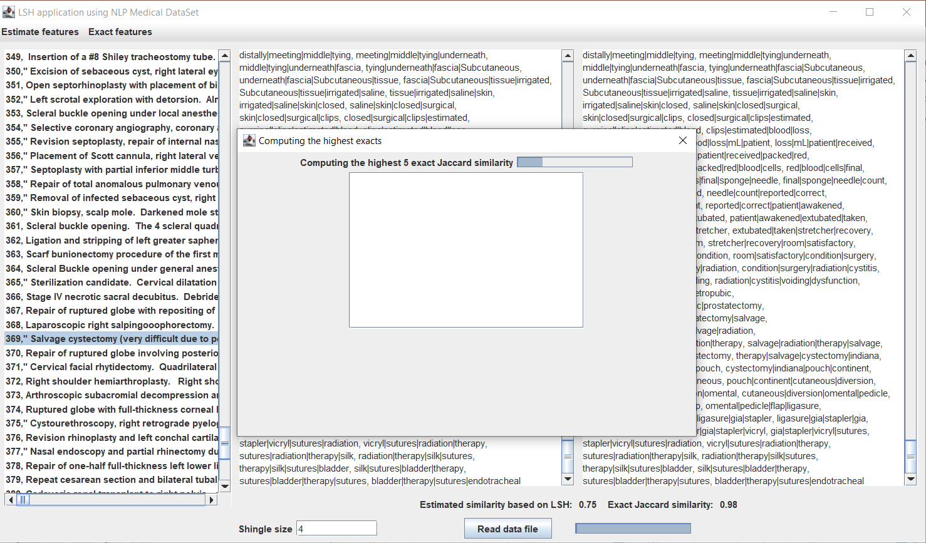
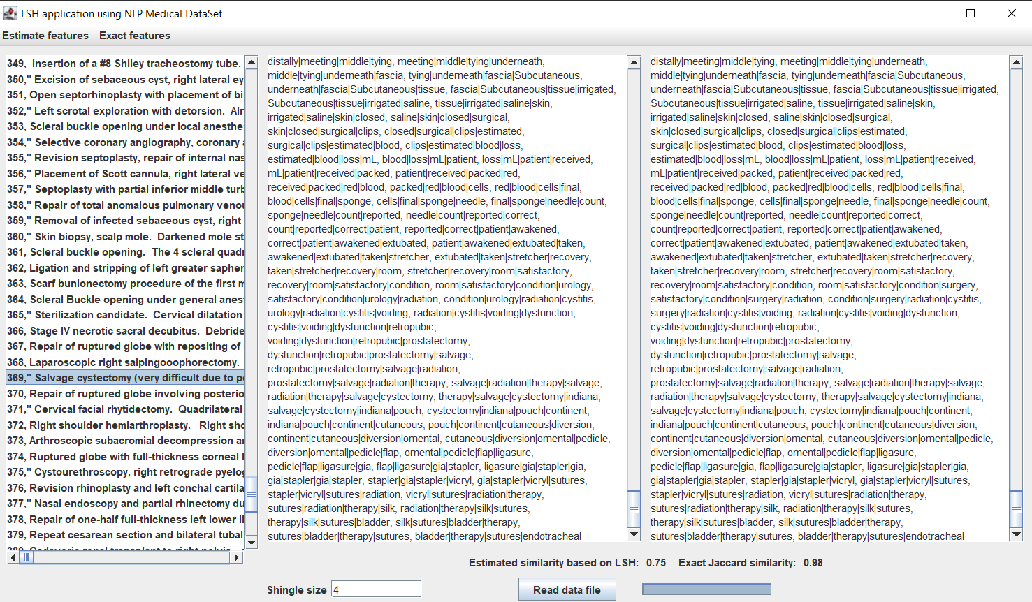
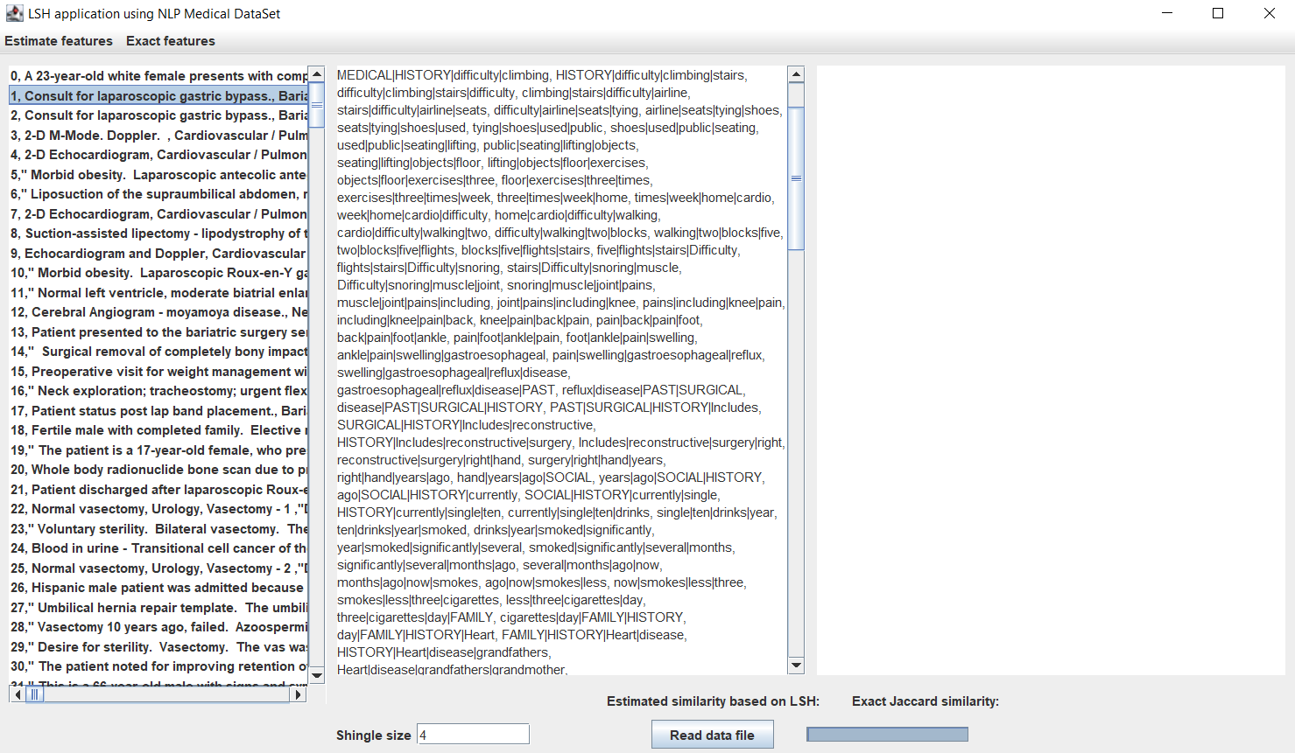
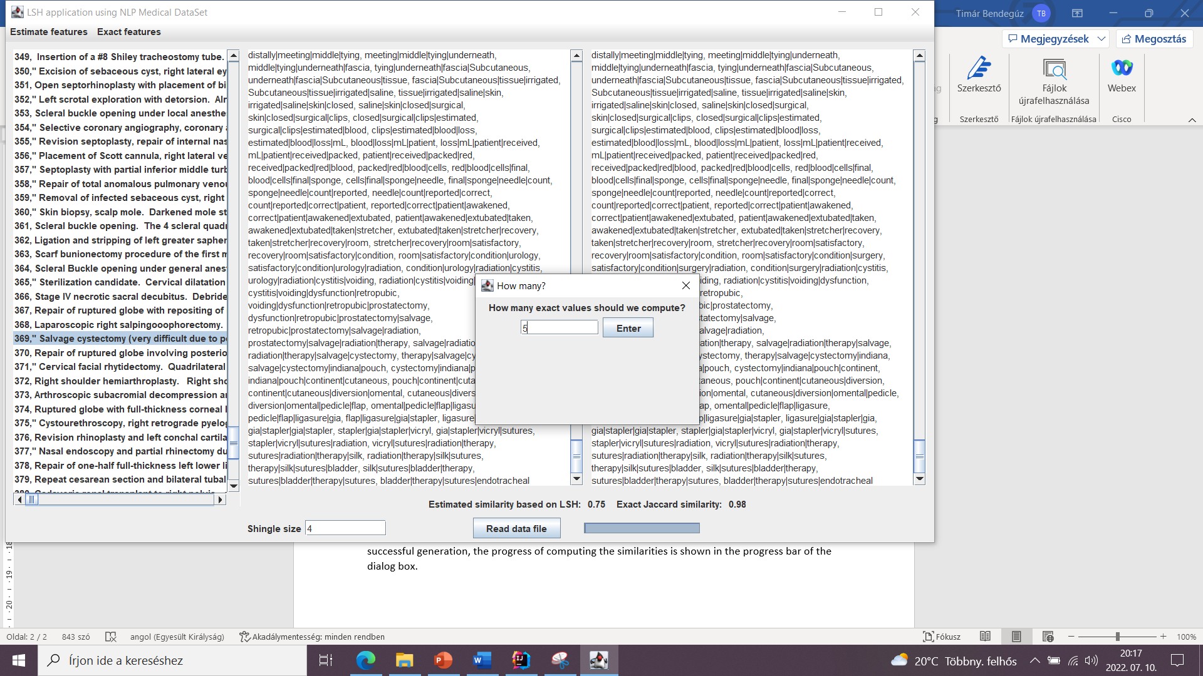
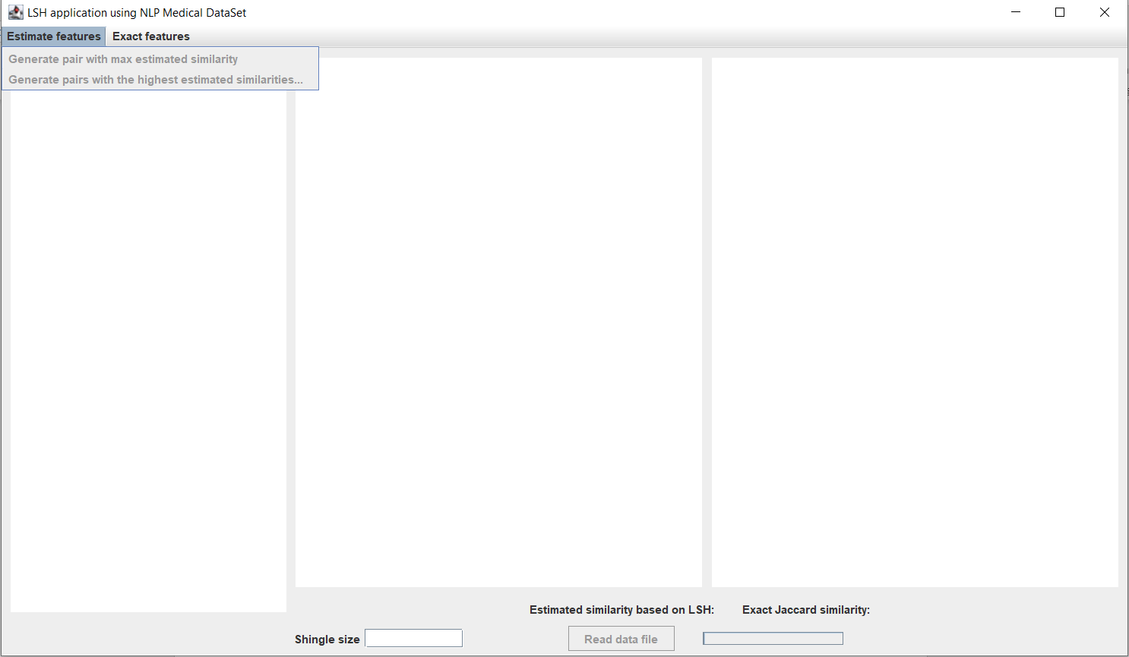

Slide 8
Thank you for your attention
https://github.com/timarbende/DataScienceHW.git
Jeffrey D. Ullman – Mining of Massive Datasets, 2014

